Slide 1
School-Based Referral Process
Respond
Review
Recognize
SRT Process
Chanel Conner
Professional School Counselor
Keystone Elementary School

Slide 2
Student Review Team (SRT)
Purpose Review student data to identify, plan for, and implement appropriate interventions and services for targeted students.
Function Develop weekly, bi-weekly or monthly meetings to discuss student referrals
Members: Team members include: School Counselor Regular Education Teacher Grade Level Teacher(s) **School administrator and other stakeholder may participate as needed **
Consultants: Mental Health Clinicians, Behavioral Specialist, Speech/Language Pathologists (SLP), Occupational Therapist (OT), Physicals Therapist (PT), School Psychologist, Nursing, Vision/Hearing and 504 Specialist
Roles: Chair/Coordinator: Recruit/Designate Team Members Schedule student referrals Maintain log/records of student referrals
Team Member: Collaborate with team members to identify and discuss appropriate interventions
Referring Teacher: Implement/monitor interventions identified to foster success in regular education classroom
Consultants: Assist with identifying, monitoring appropriate interventions and processing referrals

Slide 4
SRT Initial Referral Process
Step 1 | Submit SRT Referral Form
 | SRT Chairperson schedules initial SRT meeting SRT Chairperson or Referring Teacher notify Parent/Legal Guardian Request documents/data relevant to educational concern
Step 2 | Conduct SRT Meeting to Determine Educational Concern
 | Health Impairment Review medical/health records (e.g. certification, prescription) Review student data Collaborate with consultants as needed **Proceed to Step 4** | Non-Health Impairment or SLD Review student data Implement interventions in specific area of concern Monitor student progress (e.g. 2-to-3 weeks)
Step 3 | Assess Student Progress
 | Sufficient Progress | Insufficient Progress
 | Inform Parent/Legal Guardian of student progress Continue interventions as needed **Finalize Referral** | Proceed to Step 4: Schedule follow-up meeting Notify parent/legal guardian **Invite Parent as Needed**

Slide 6
Useful Information
Physical/Mental Impairment | Any physiological condition that affects a bodily system, or any mental or psychological disorder
Student Data | Student Demographics Enrollment History Attendance Discipline History Achievement Test Grades Medical Documents Work Samples Observations
Skill Deficit (RTI 2) | Basic Reading Skills Reading Comprehension Reading Fluency Math Calculation Math Problem Solving Written Expression
SPED Eligibility Criteria (Non-SLD) | Autism Developmental Delay (DD) Emotional Disturbed (ED) Functional Delay (FD) Intellectual Disability (ID) Other Health Impaired (OH)

Slide 7
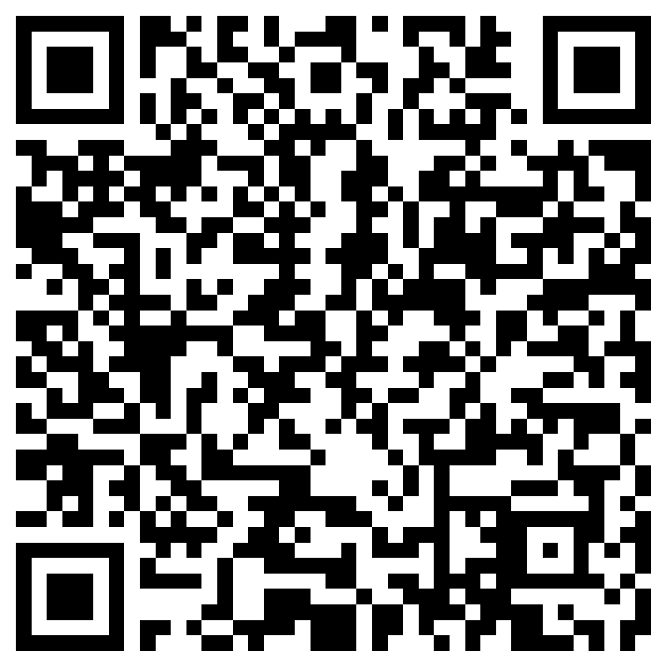
Attendance:
School-Based Referral Process
Click here or use the QR Code to submit attendance.

